Slide 1
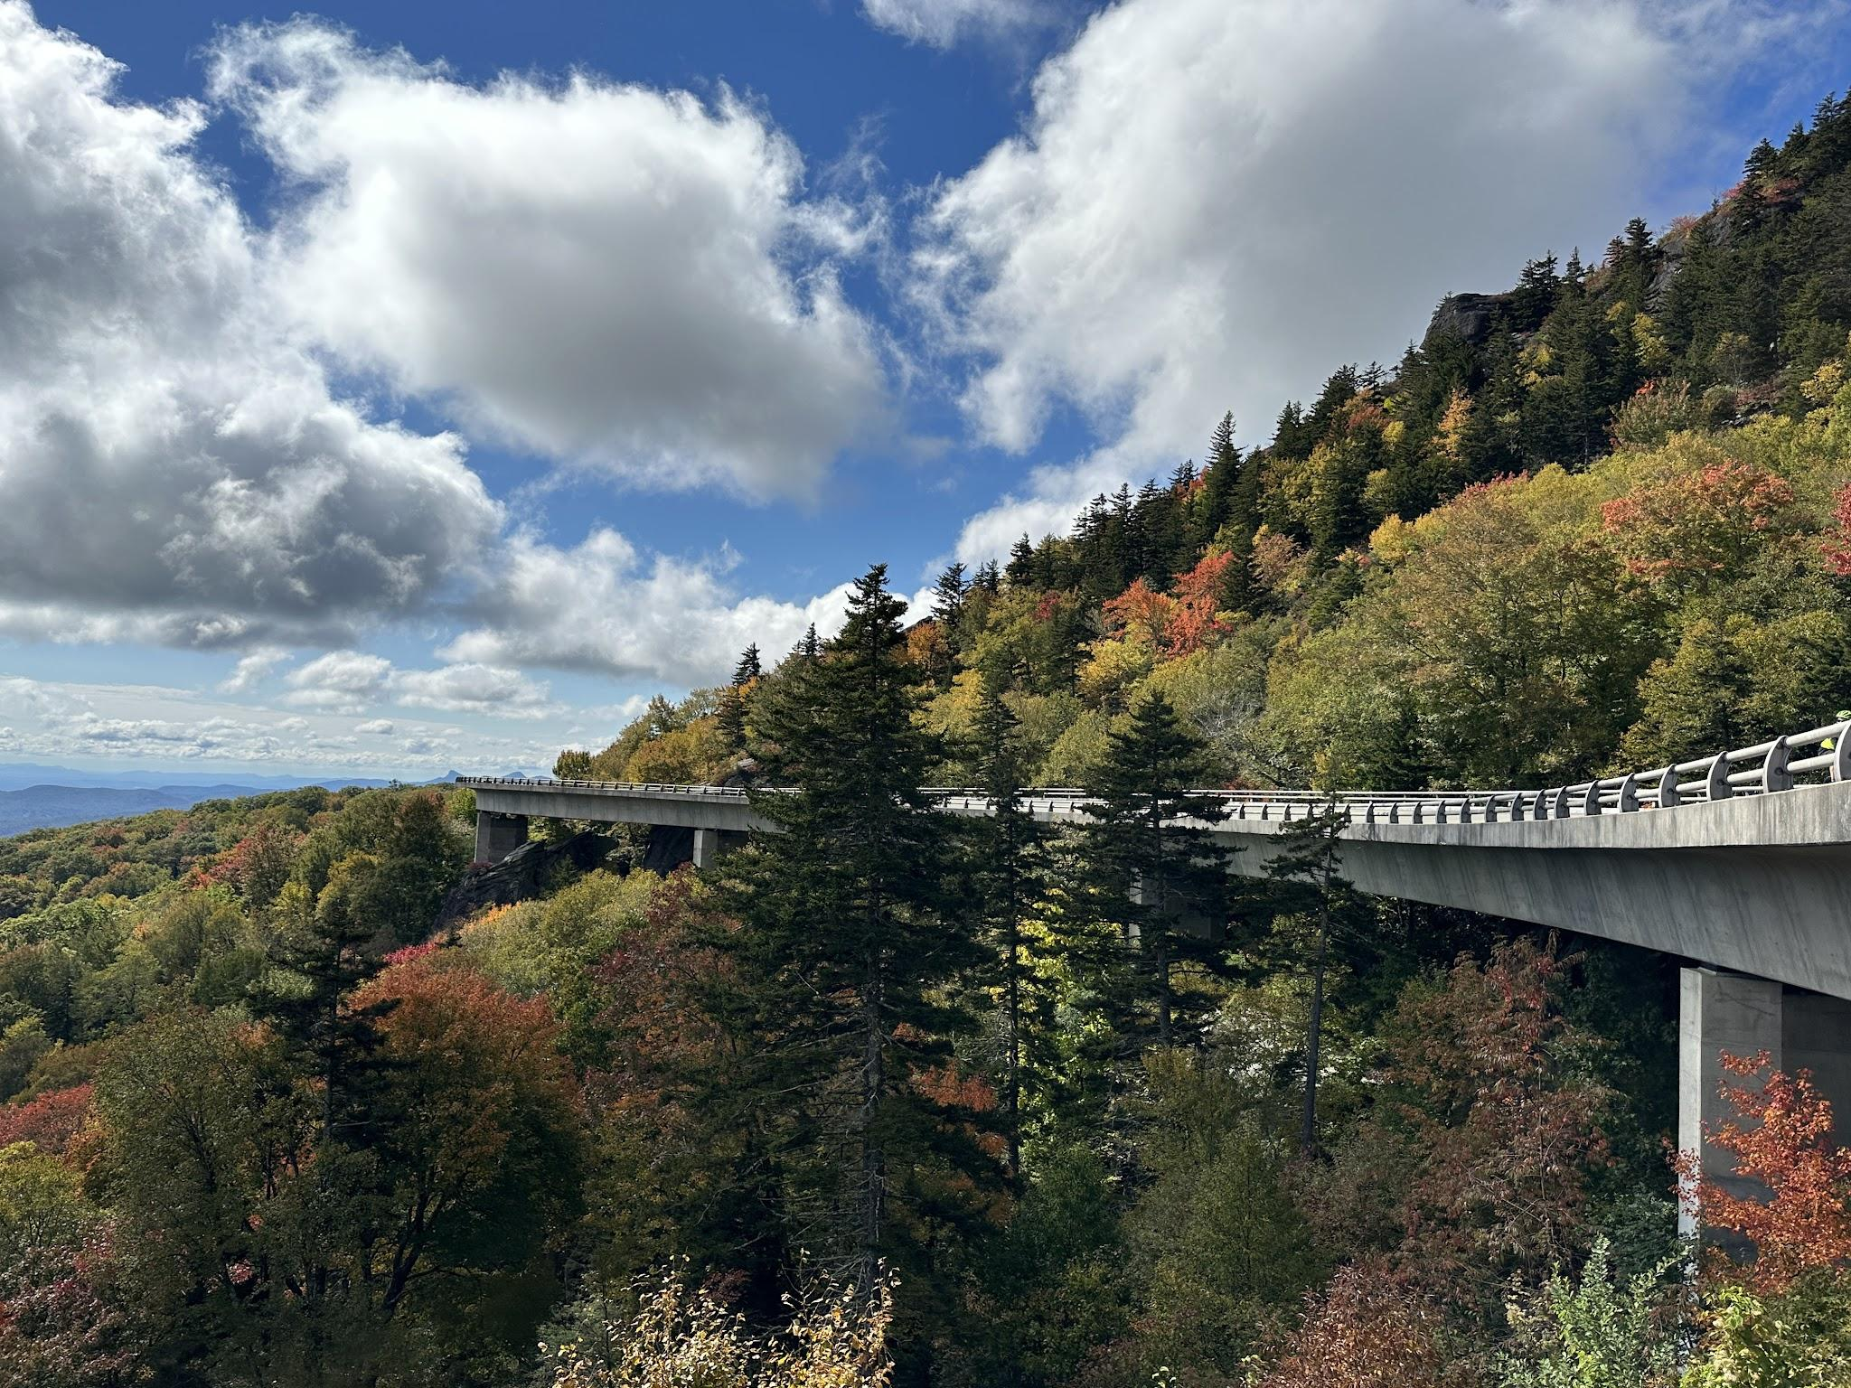
The Last Heist
Sam Johnson, Will Speakman Spencer Holie & Hana Johnson

Slide 2
Concept
Description
Motivation for development?

Slide 3
Elevator Pitch
We want to provide a rental car website with as much information as possible. We want the consumer to be able to pick the car they are most comfortable with. We will need to provide as much information on these vehicles as possible, which will give our consumers the ability to make an informed decision

Slide 4
Process
Technologies used
Breakdown of tasks and roles
Challenges
Successes

Slide 5
Technologies Used
Javascript
Schema
Apollo
MongoDB
Express
GraphQL

Slide 6
Tasks & Roles
Hana: stripe, jwt & cart/schedule
William: GraphQL, Mongo, Seed Data & Seeding DB, Heroku, assist with React and CSS
Sam: Front end, queries, assist with backend
Spencer: CSS styling, seed data & photos, README, Front end

Slide 7
Strengths & Weaknesses
Teamwork, working together, asking questions when stuck, walking through answers with each other
Having an idea early and being able to get a nice start with focusing on our task
A lot of little things
GraphQL instead of using CRUD
Connecting to individual components
CSS/Bootstrap

Slide 8
Demo

Slide 9
Directions for Future Development
API for additional cars
More search options (price, history)
User engagement (comments, ratings, feedback comments
Employees - giving the ability to add & update cars/users
User history

Slide 10
Links
Deployed
https://github.com/sjohn294/thelastheist

